Slide 1
Sleep Data Analysis
Team: Megan, Misty, Jordan, Laura, Danny

Slide 2
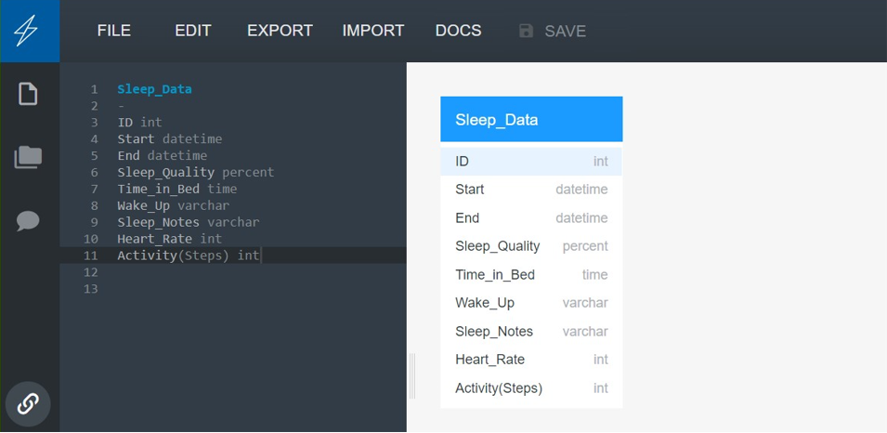
Our Data Set
https://www.kaggle.com/danagerous/sleep-data

Slide 3
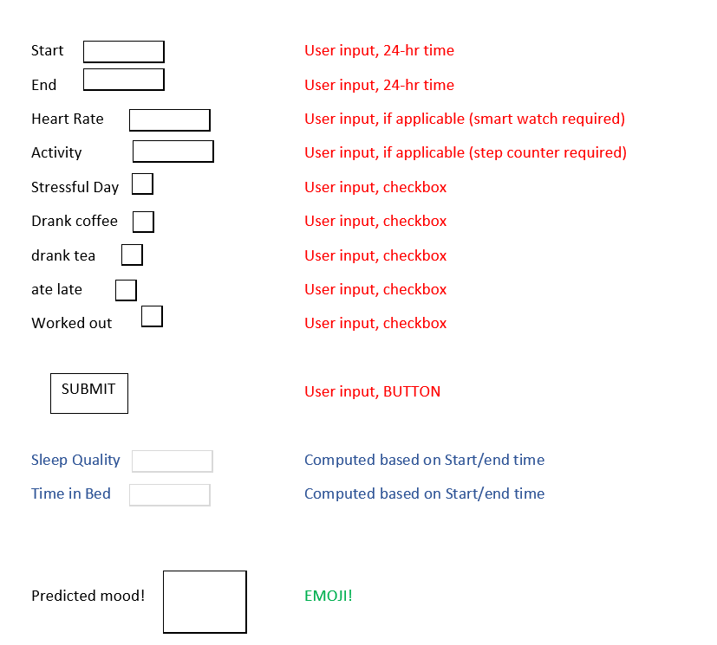
How will I feel when I wake up?
Plan: Build a website for people to predict how they feel when they wake up given the other parameters in the data set being imputed by the user. The output would be an emoji.
Issues: During preprocessing we saw our data set would be very small and would not do well with multiple models.

Slide 4
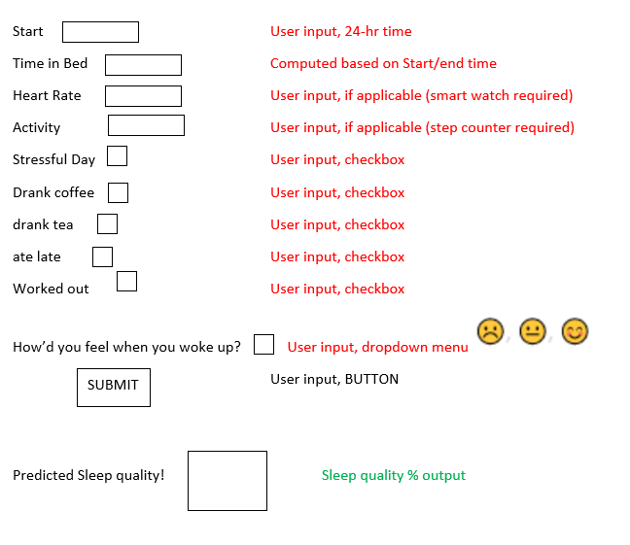
Change of course…..New Plan! New Question!
What was the quality of my sleep?
New plan: We will still build a website, but instead of predicting how we will wake up feeling, we predict the quality of the sleep that we had.
Pros: We can use more of our data.
More machine learning models are at our disposal.

Slide 5
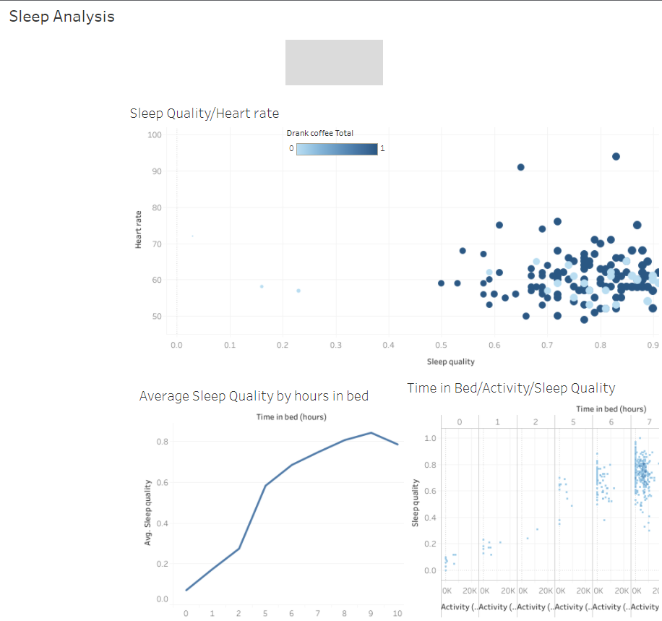
Tableau Story
Tableau Story

Slide 6
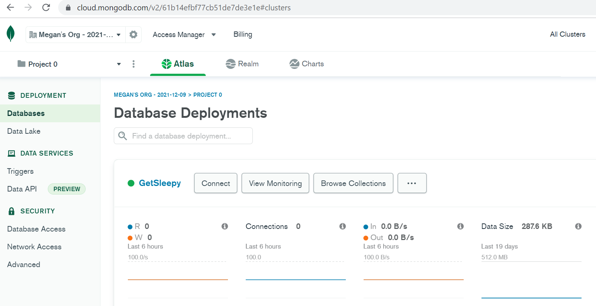
Our Database of Choice: MongoDb Atlas
Pros:
Free, simple,
High speed,
flexible

Slide 7
Currently…..
Our group is trying out different machine models to see what models work well and which don’t.
We are also taking time to dig into why certain models do not work so well for our data set.

